Slide 1
Lecture 16

Slide 2
A simple attack on textbook RSA
Client Hello
Web Browser
Web
Server
Server Hello (e, N)
Random session key K
d
C = RSA (K)
Session-key K is 64 bits. View K ∈ {0,…,2⁶⁴}
Eavesdropper sees: C = K^{e} (mod N) .
Suppose K = K₁⋅K₂ where K₁, K₂ < 2³⁴ .
Then: C/K₁e = K₂e (mod N)
Build table: C/1e, C/2e, C/3e, …, C/2^{34e} . time: 2³⁴
For K₂ = 0,…, 2³⁴ test if K₂e is in table. time: 2³⁴⋅34
Attack time: ≈2⁴⁰ << 2⁶⁴

Slide 3
Message Authentication

Slide 4
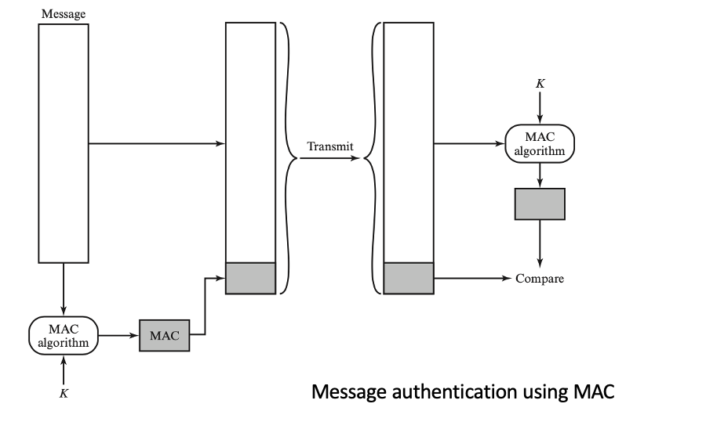
Message authentication
message authentication is concerned with:
protecting the integrity of a message
validating identity of originator
non-repudiation of origin (dispute resolution)
then four alternative functions used:
message encryption - symmetric
hash function
message authentication code (MAC)
digital signature

Slide 5
Message encryption
message encryption by itself also provides a measure of authentication
if symmetric encryption is used then:
receiver knows sender must have created it
since only sender and receiver know key used
know content cannot be altered

Slide 6
Message encryption
if public-key encryption is used:
encryption provides no confidence of sender
since anyone potentially knows public-key
so, need to recognize corrupted messages
however, if
sender signs message using their private-key
then encrypts with recipients’ public key
have both secrecy and authentication
but at cost of two public-key uses on message

Slide 7
Hash Function

Slide 8
Hash functions
Hash function: h = H(M)
M can be of any size
h is always of fixed size
Typically, h << size(M)

Slide 9
Reasons to avoid encryption authentication
Encryption software is quite slow
Encryption hardware costs are nonnegligible
Encryption hardware is optimized toward large data sizes
An encryption algorithm may be protected by a patent

Slide 10
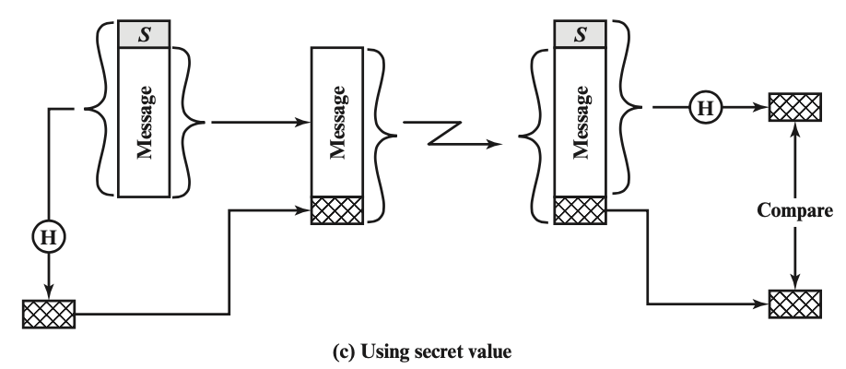
Message authentication using hash function
Initialization: A and B share a common secret, S_{AB}
Message, M
A calculates MD_{M} = H (S_{AB} || M)
B recalculates MD’_{M}, and check
MD’_{M} = MD_{M}

Slide 11
Requirements for secure hash functions
1. can be applied to any sized message M
2. produces fixed-length output h
3. is easy to compute h=H(M) for any message M
4. given h is infeasible to find x s.t. H(x)=h
one-way property or preimage resistance
5. given x is infeasible to find x’ s.t. H(x’)=H(x)
weak collision resistance or second pre-image resistant
6. infeasible to find any pair of x,x’ s.t. H(x’)=H(x)
strong collision resistance

